Slide 1

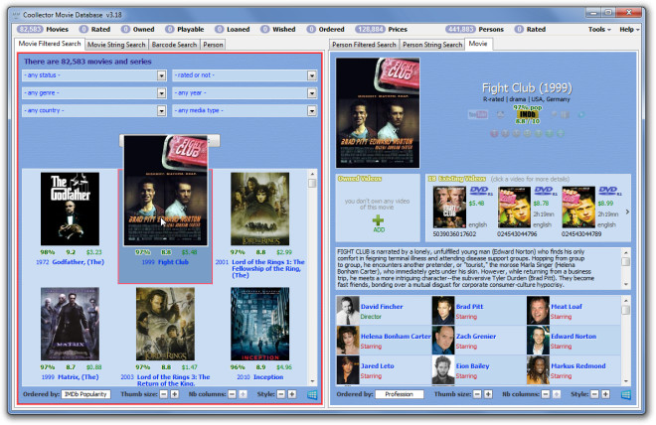
Movie Database in 3 Engines By: Basil Latif

Slide 2
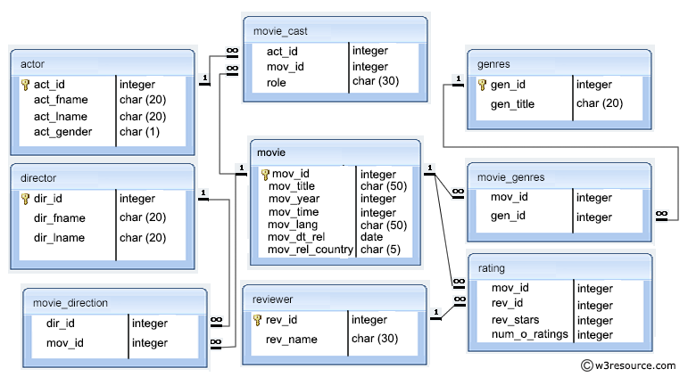
Project Description
My application will provide a way to to query 3 movie databases
The audience is anyone who wants to analyze facts about movies
A large movies dataset will be imported into 3 db engines-Postgres, Cassandra, and ElasticSearch
It will be used by movie fans

Slide 3
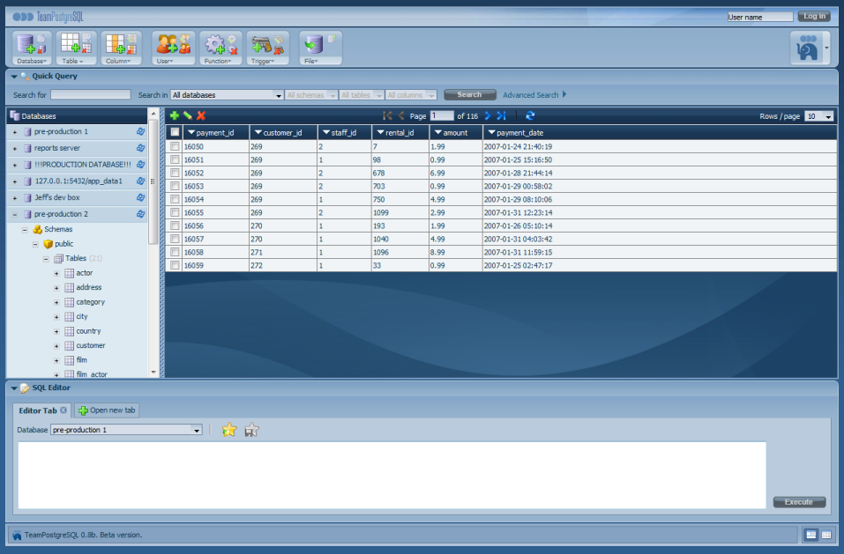
User's point of view
I will be designing a front-end
A web page will be able to access my databases

Slide 4
Why you are interested:
I am interested in databases
They are a very logical way to keep records of data
I want to gain expertise in as many database languages as possible and become a database developer

Slide 5
"Questions" slide
?

